Slide 1


Introduction
ACCESSDATA® FORENSICS
Working with Registry Viewer
Forensic Analysis
Incident Response
eDiscovery
Information Assurance

Slide 2
Module Objectives
Menus / Icons / Properties / Interpreters
Chronological MRU Lists
Common Areas (Favorites)
Searching the Registry
HTML Reports (Case Links)
Defined Summary Reports
Context-Sensitive Help
UTK Integration (FTK / PRTK)

Slide 3
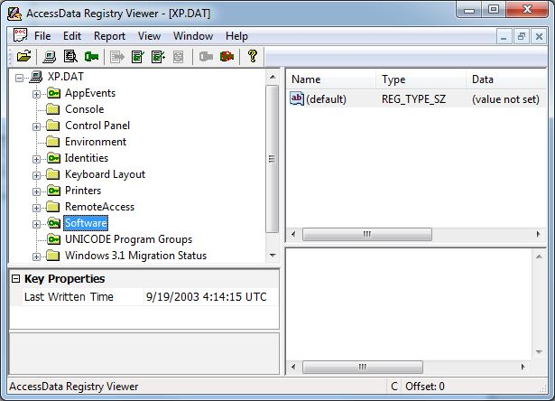
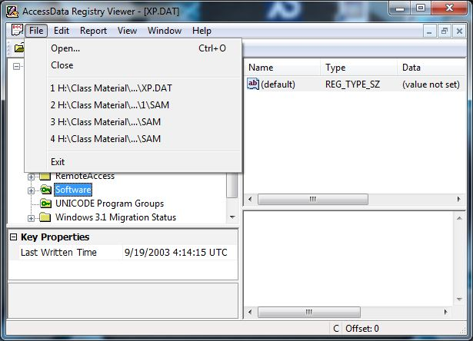
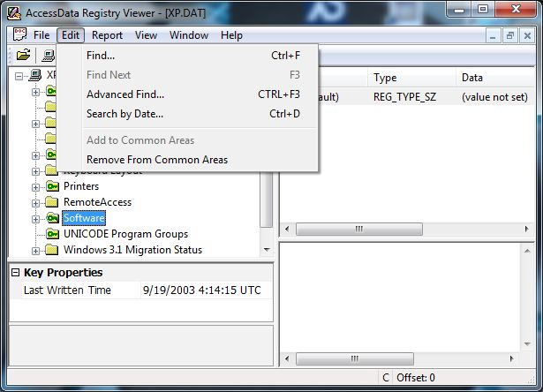
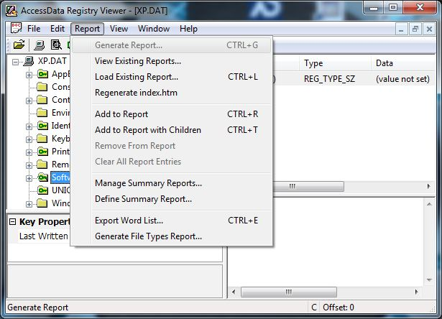
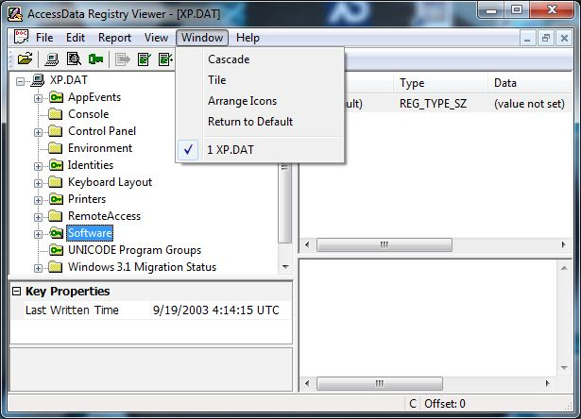
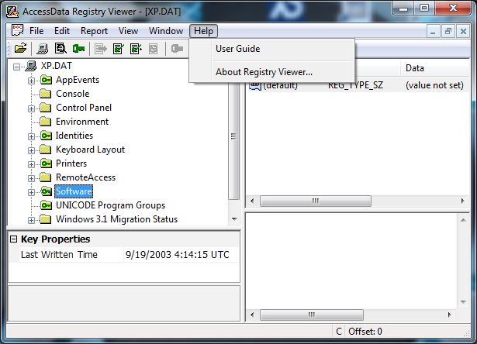
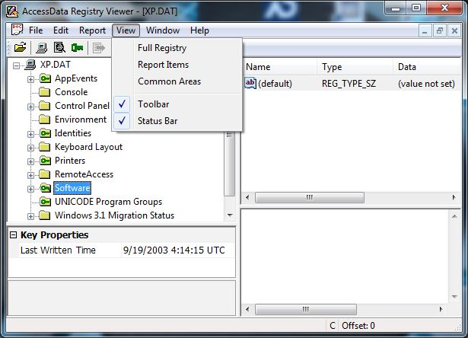
File Menus

Slide 4
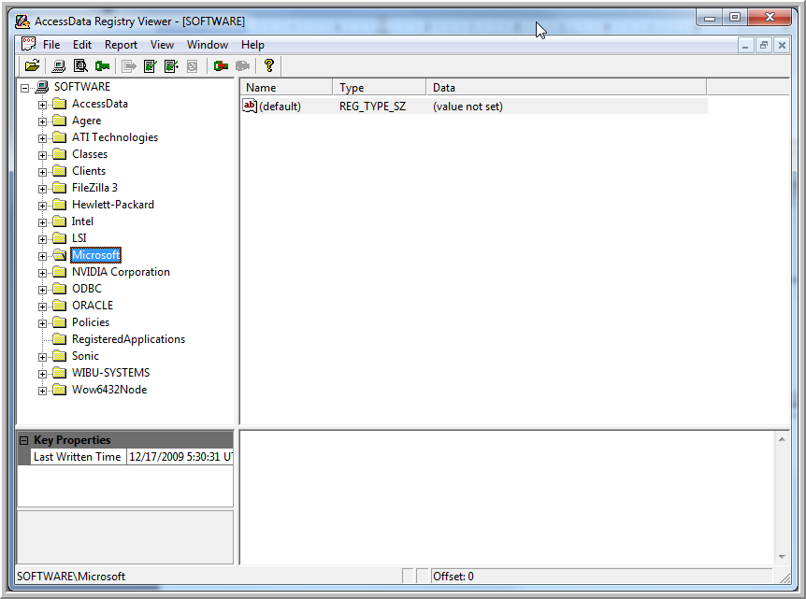
Tool Icons

Slide 5
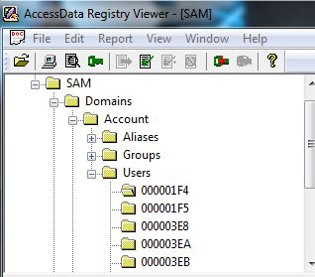

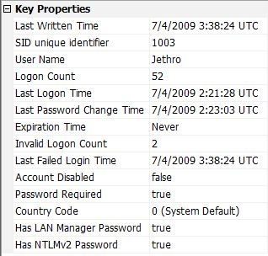
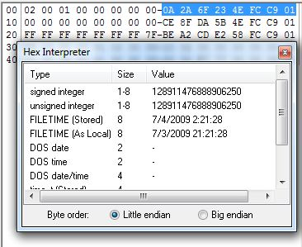
Properties and Interpreters

Slide 6
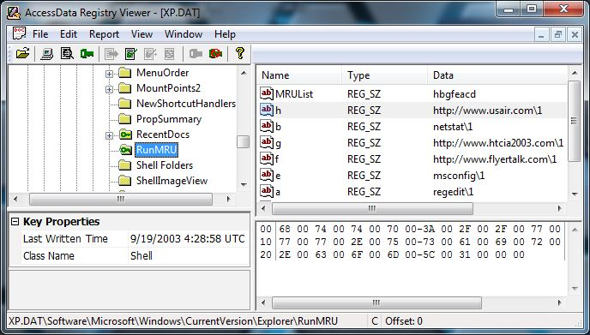
Chronological MRU Lists

Slide 7
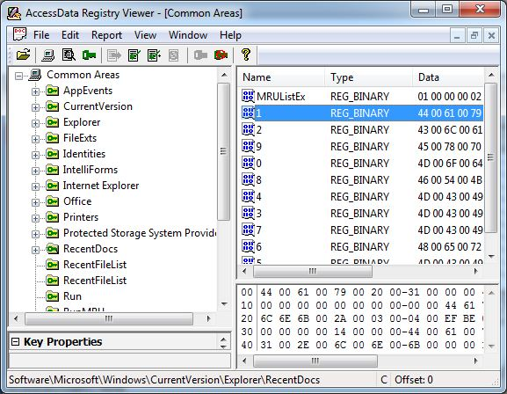
Common Areas (Favorites)

Slide 8
Searching the Registry
There are 3 methods to search the data
Quick Find
Advanced Find
Search by Last Written Date

Slide 9
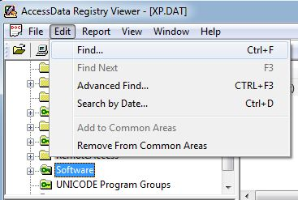
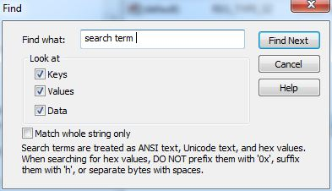
Quick Find
Searches in the selected key and its children

Slide 10
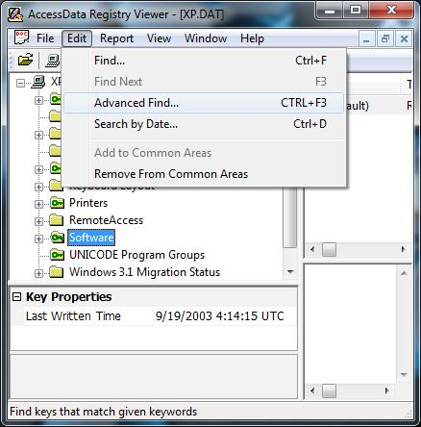
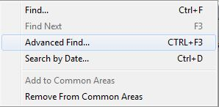
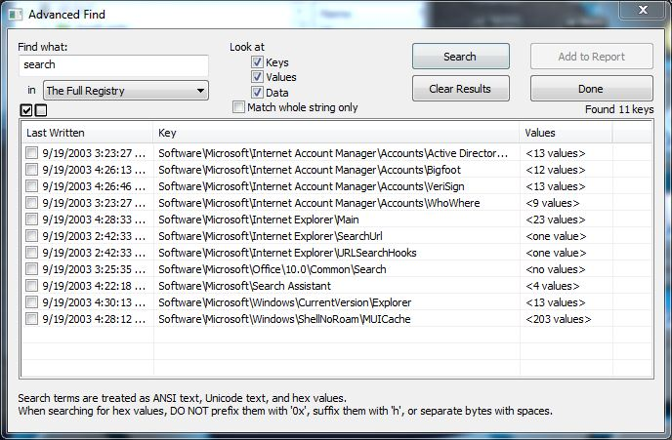
Advanced Find
Select search type

Slide 11
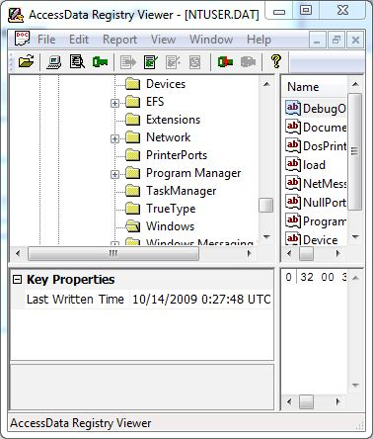
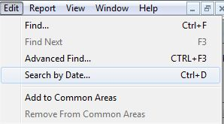
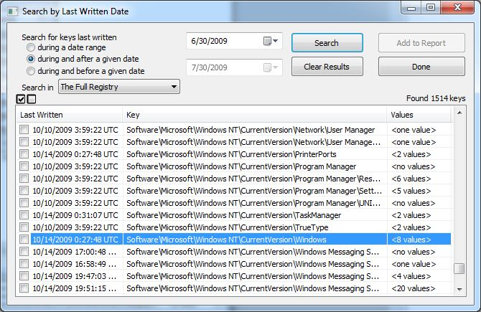
Searching by Date - Last Written

Slide 12
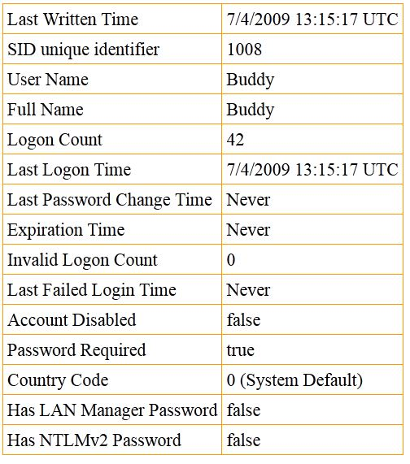
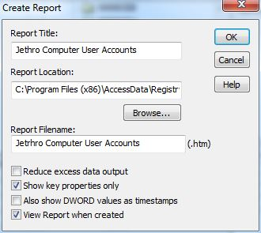
HTML Reports
C:\Program Files\AccessData\AccessData\Registry Viewer\report
On 64 bit systems - C:\Program Files(x86)\AccessData\. . .

Slide 13
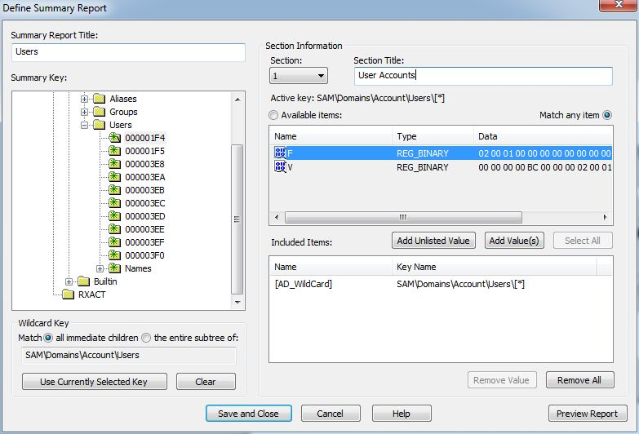
Defined Summary Reports
Individual key values vs.
Entire keys
Including
wildcard
abilities !

Slide 14

Wildcards
  Two types are used to capture values from multiple registry files:
    Specified values in
    direct subkeys
    Specified values
    in selected key
    and descendants
value
value
value
value
value
value
value
value
value

Slide 15
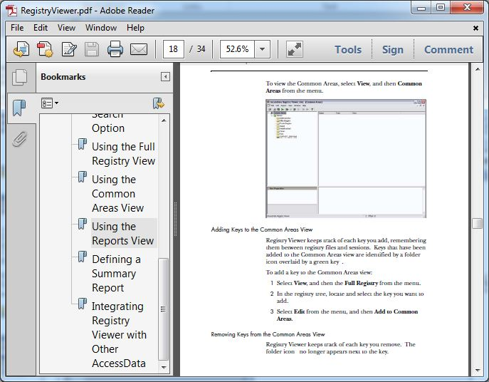
Context Sensitive Help

Slide 16
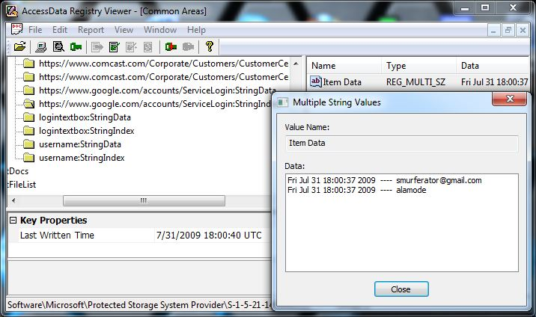
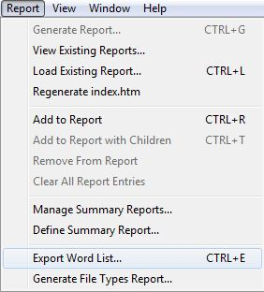
UTK Integration – PRTK
Decrypted Passwords !

Slide 17
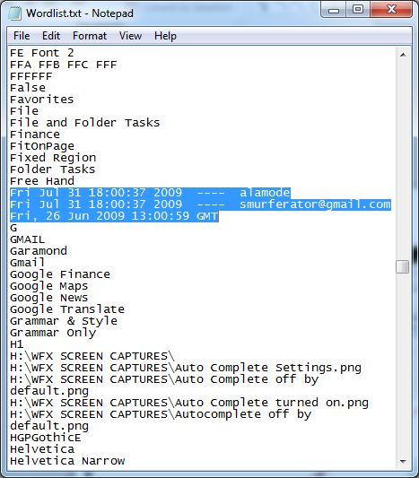
UTK Integration – PRTK
What do you do with this ?
(or make user-defined)

Slide 18
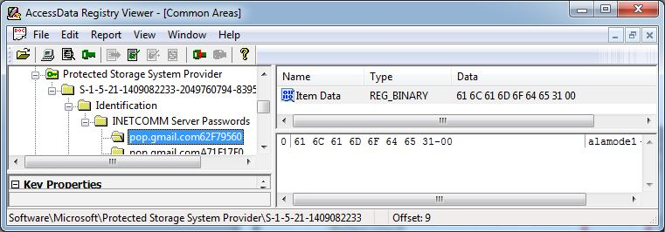
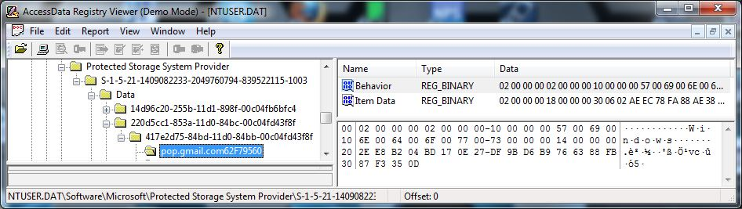
Demo Mode
Dongle
No Dongle

Slide 19
Module Review
Menus / Icons / Properties / Interpreters
Chronological MRU Lists
Common Areas (Favorites)
Searching the Registry
HTML Reports (Case Links)
Defined Summary Reports
Context-Sensitive Help
UTK Integration (FTK / PRTK)

Slide 20



